Slide 1

Redesigning CoLab
Improving Collaboration for Teachers and Students
Allison Espana, Emily Alta, Micah Modell

Slide 2

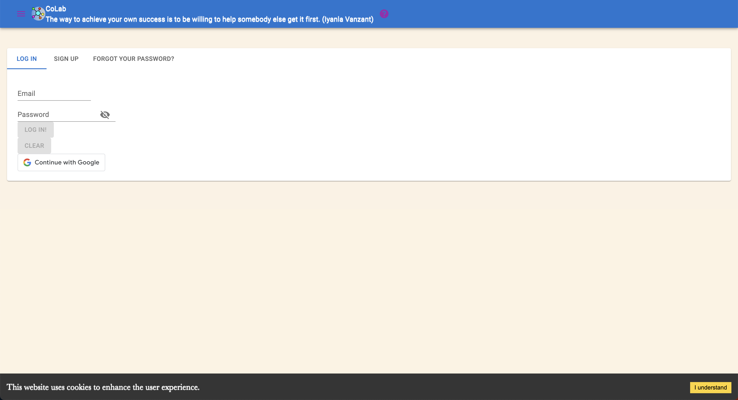

PREDISPOSITIONS
Coding?
CoLab?
What is this?
Notes:
Preconception: what we had to begin with… looking at first glance

Slide 3
INSIGHTS

Slide 4
INSIGHTS

Slide 5
CONCEPT SYSTEMS
Notes:
Here we can explain our ideas behind every color/design… etc…

Slide 6
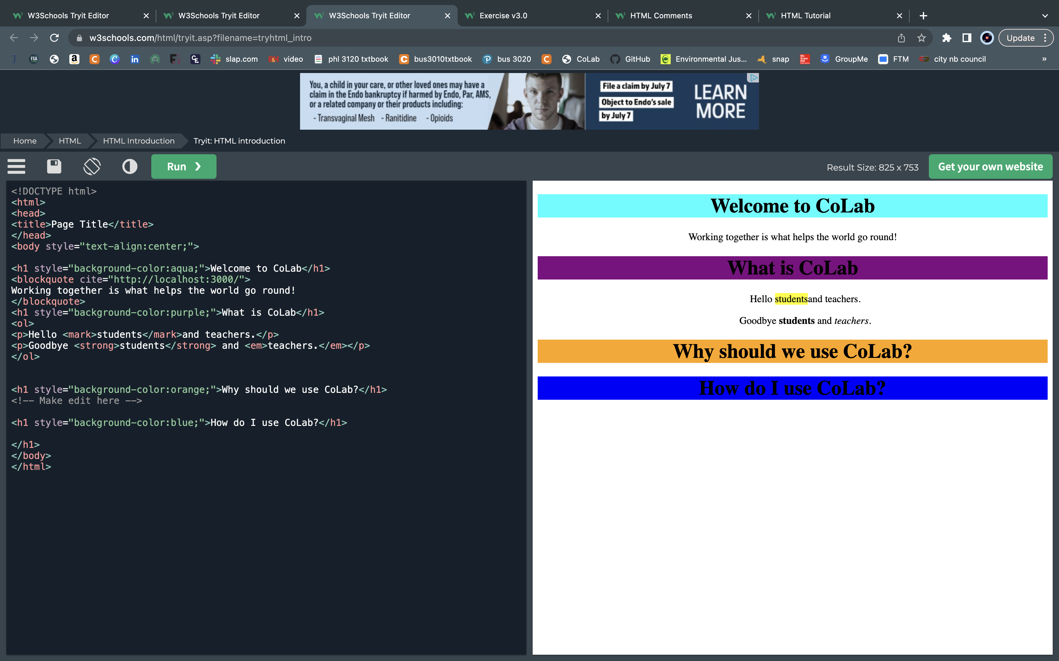
PROTOTYPES
Notes:
This is one of the first prototypes… developed in w3schools… made for practice

Slide 7
STRATEGIES
Classroom
Work
Group Work
Teachers will use this to check up on students and intervene if anything happens
Managers will use this to keep track of their employees’ improvement
Born into the real world

Slide 8

TABLE OF CONTENTS
ABOUT US
Elaborate on what you want to discuss.
OUR PROJECTS
STATS & NUMBERS
Elaborate on what you want to discuss.
Elaborate on what you want to discuss.

Slide 9


ABOUT US
Elaborate on what you want to discuss.

Slide 10

MISSION
VISION
Enter your grand
vision statement!
Enter your grand
vision statement!

Slide 11

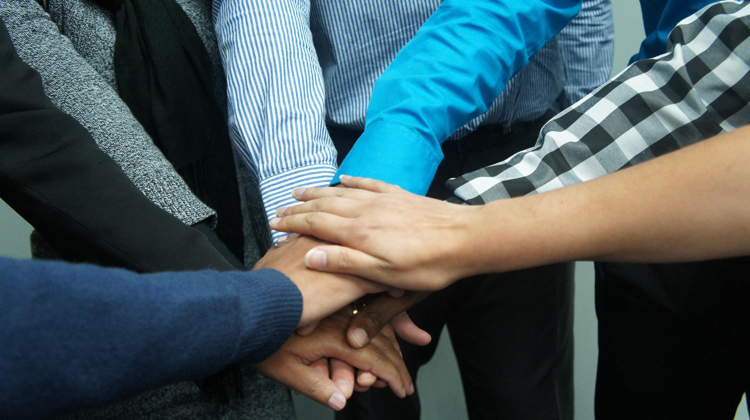
ABOUT US
WHO WE ARE?
Briefly elaborate on what you want to discuss.
WHAT WE DO?
Briefly elaborate on what you want to discuss.

Slide 12
ADD A TABLE
ADD A MAIN POINT Briefly elaborate on what you want to discuss. | ADD A MAIN POINT Briefly elaborate on what you want to discuss. | ADD A MAIN POINT Briefly elaborate on what you want to discuss.
ADD A MAIN POINT Briefly elaborate on what you want to discuss. | ADD A MAIN POINT Briefly elaborate on what you want to discuss. | ADD A MAIN POINT Briefly elaborate on what you want to discuss.

Slide 13

A PICTURE IS WORTH A THOUSAND WORDS

Slide 14
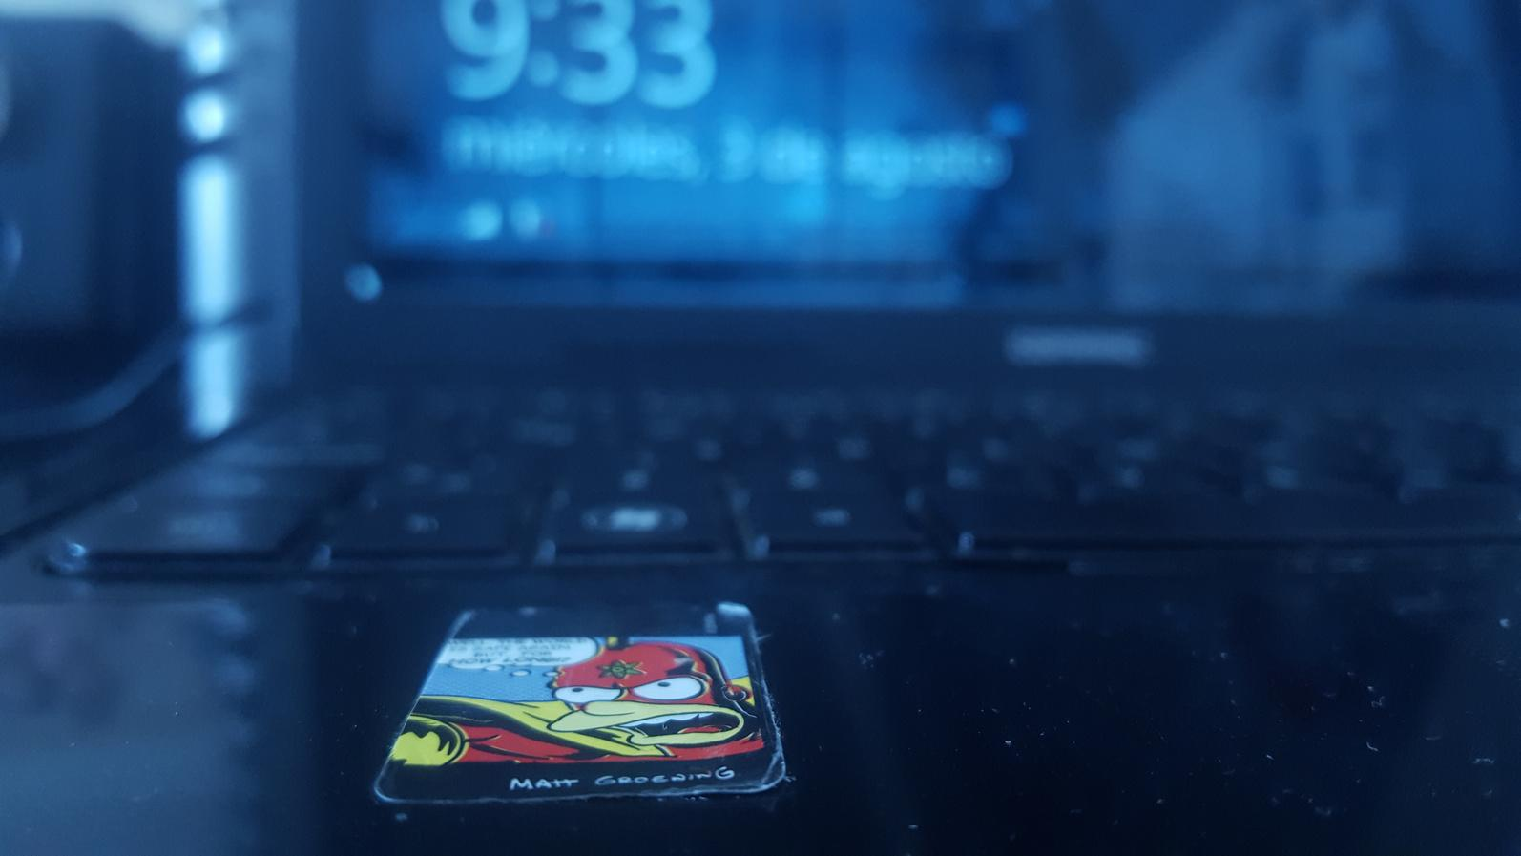
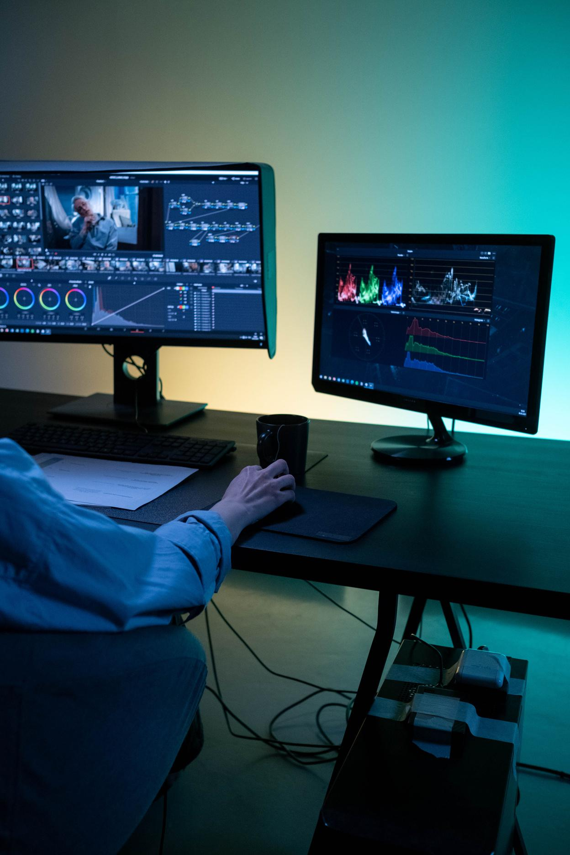
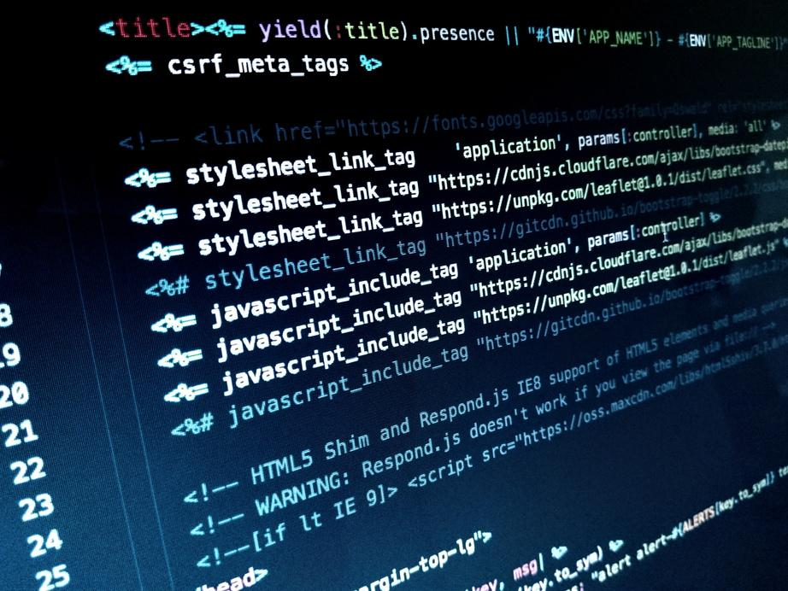
CREDITS
This presentation template is free for everyone to use thanks to the following:
SlidesCarnival for the presentation template
Pexels for the photos
HAPPY DESIGNING!

Slide 15
THANK YOU!
Write a closing statement or call-to-action here.

